Slide 1
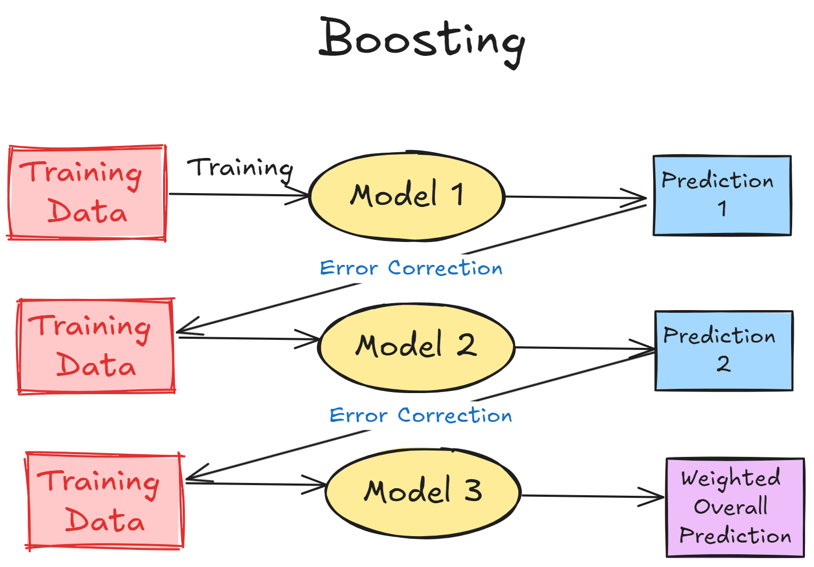
Gradient Boosting
What is boosting?
The Process of boosting
Types of Gradient Boosting Algorithms
Applications
Code Implementation

Slide 2
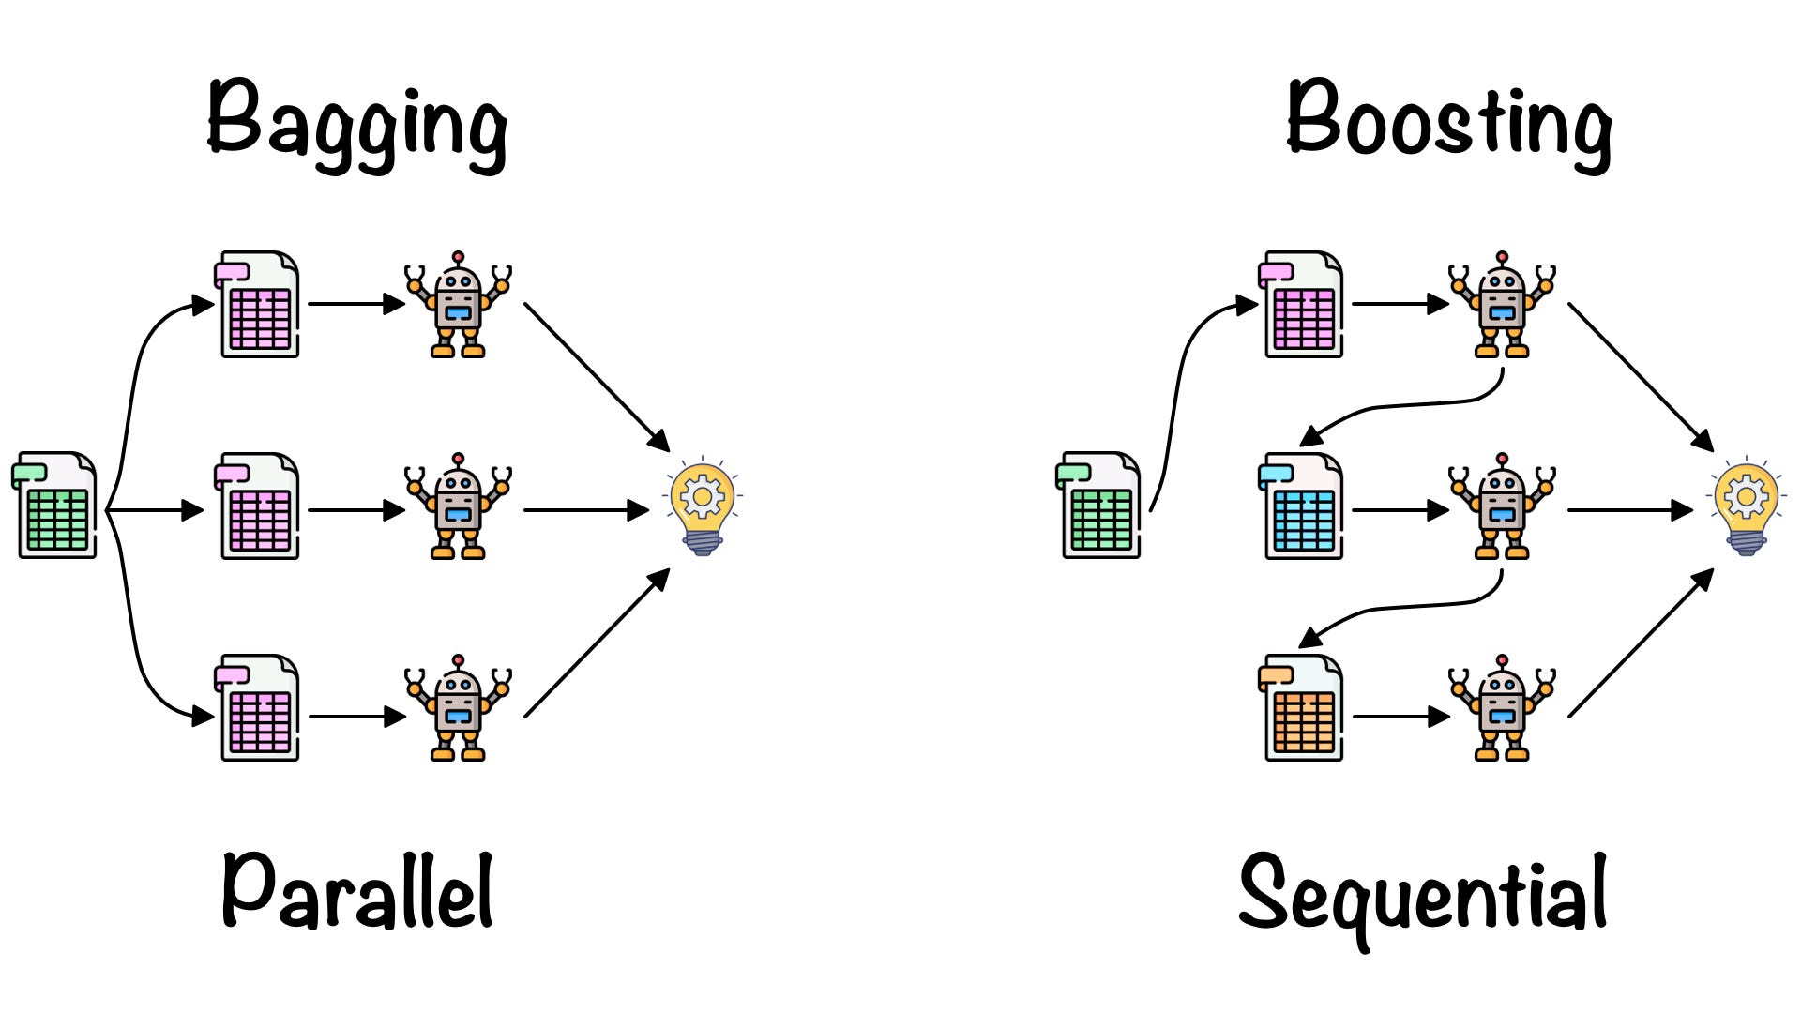
What is boosting?
Boosting is an ensemble learning technique where multiple weak learners (usually shallow decision trees, also called "stumps") are combined sequentially to create a strong learner. Unlike Bagging (Random Forest), where models are trained independently in parallel, Boosting trains models one after another, with each new model trying to fix the errors of the previous one.
Each tree is trained on the residual errors (difference between the actual and predicted values) of the previous model.

Slide 3
The Process of boosting

Slide 4
Types of Gradient Boosting Algorithms
Vanilla Gradient Boosting (GBM)
XGBoost (Extreme Gradient Boosting)
LightGBM
CatBoost

Slide 5
Applications
Domain | Use Case
🛒 E-commerce | Customer segmentation, recommendation engines
💳 Finance | Credit scoring, fraud detection
🏥 Healthcare | Disease prediction, patient risk assessment
📈 Marketing | Predicting customer churn
📊 Data Science | Kaggle competitions (widely used model)
🔍 Search Engines | Ranking search results

Slide 6
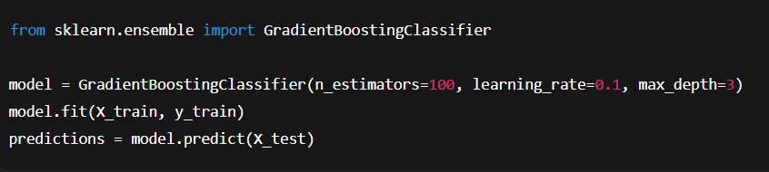
Code Implementation
Parameter | Description
n_estimators | Number of trees to build
learning_rate | Controls contribution of each tree
max_depth | Maximum depth of each tree

